Slide 1



CROP & FERTILIZER RECOMMENDATION SYSTEM USING MACHINE LEARNING
Student Name:BASHAYER.M
AICTE Stu_ID:STU65c84334163681707623220

Slide 2

Learning Objectives
Learn the impact of over- or under-use of fertilizers on crops and the environment.
Collect agricultural datasets and perform data cleaning, model training etc.
Extract and create relevant features such as soil nutrients,temperature, humidity, rainfall,etc.
Train model to predict the most recommended fertilizers based on input parameters.
Build logic to recommend suitable crops and corresponding ferlilizer for given condition.
GOAL
Source :
www.freepik.com/

Slide 3
Tools and Technology used
Programming Language: Python
Libraries: Numpy, Pandas, Seaborn, Matplotlib
Techniques : Machine Learning
Algorithm : Decision Tree Classifier
Platforms: Jupyter notebook or Google Collab

Slide 4
Methodology
1. Problem definition: Recommend suitable crop & Fertilizer based on soil and environmental factors.
2. Data Collection: Gather data on soil(N,P,K,pH), weather(temp.,rainfall), and crops from open source.
3. Data Preprocessing: Clean, normalize, and encode data; handle missing values and outliers.
4. Model Training: Train Machine Learning model using Decision Tree for crop and fertilizer classification.
5. Model Evaluation: Evaluate using Accuracy, precision, F1-score, and cross-validation.
6. Recommendation System: Suggest Crops and Fertilizers based on model predictions and agricultural rules.

Slide 5
Problem Statement:
Design a machine learning-based recommendation System to suggest the most suitable crops and fertilizes for a given piece of agricultural land. The system should analyse soil properties, weather conditions and other relevant parameters to optimize agricultural productivity and sustainabiility.

Slide 6
Solution:
Intelligent Recommendation Engine & Sustainable Agriculture:
- Uses machine learning models to suggest the most suitable crop and fertilizers based on real-time environmental and soil data.
- Reduces fertilizer overuse and increase yield, promoting eco-friendly and cost-effective farming practices.

Slide 7
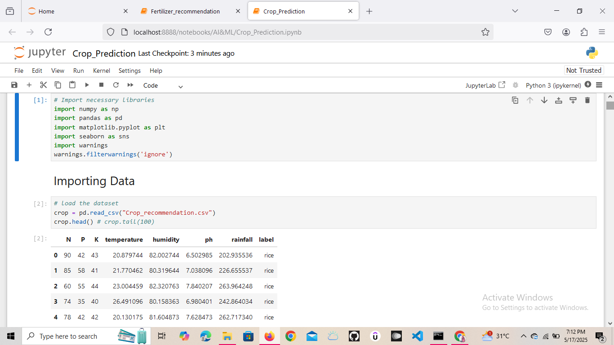
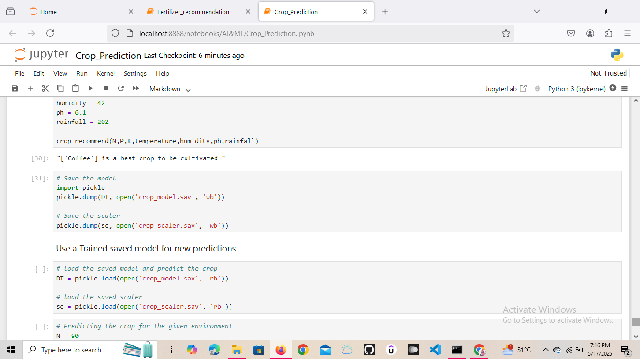
Screenshot of Output:

Slide 8
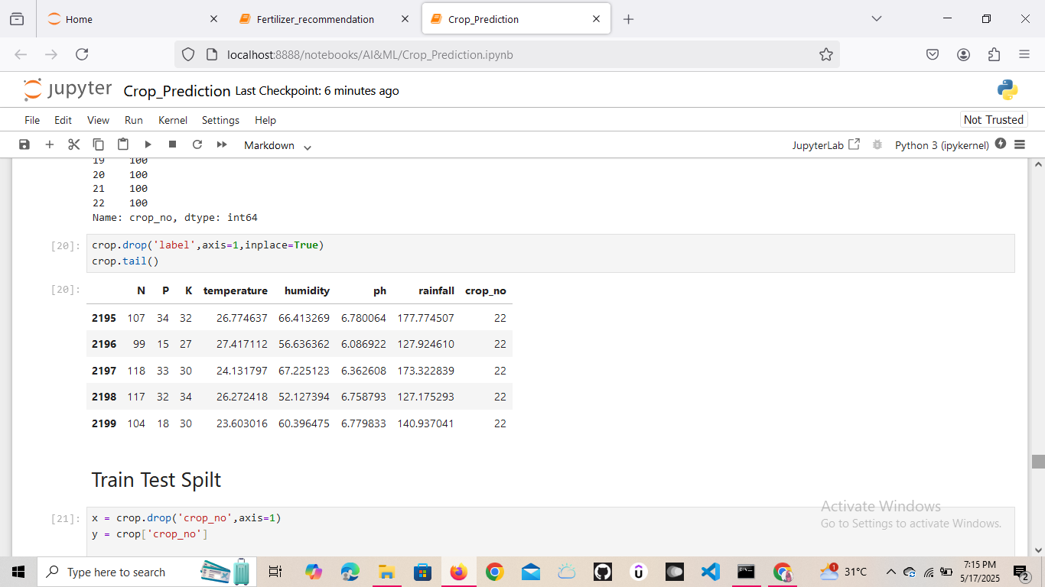
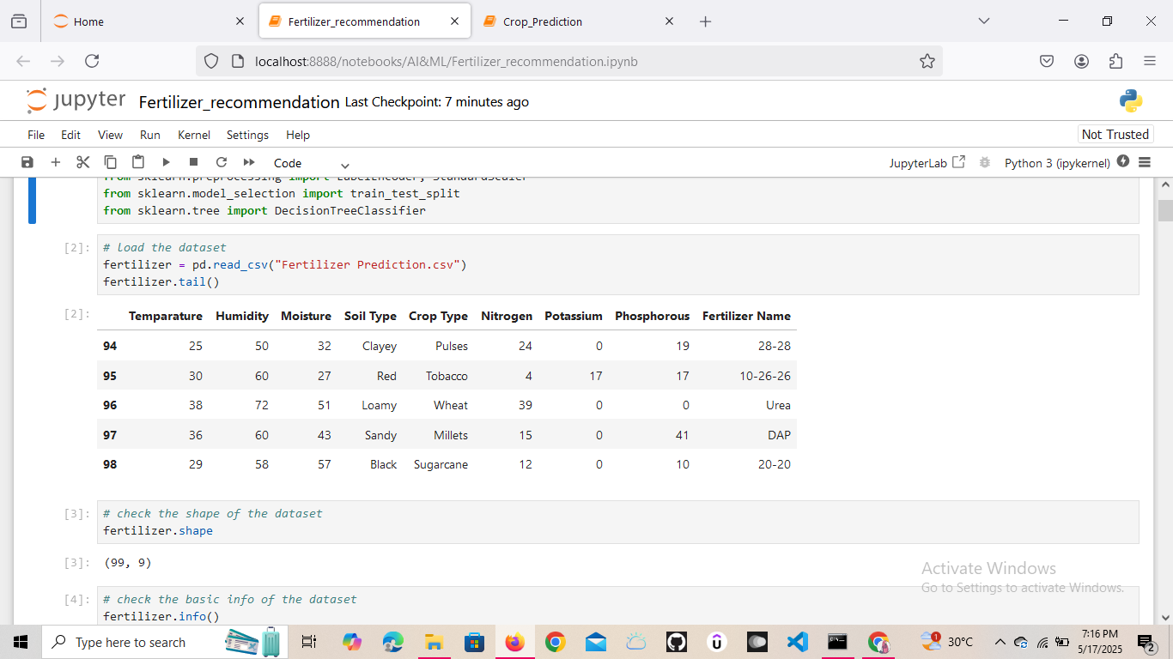

Slide 9
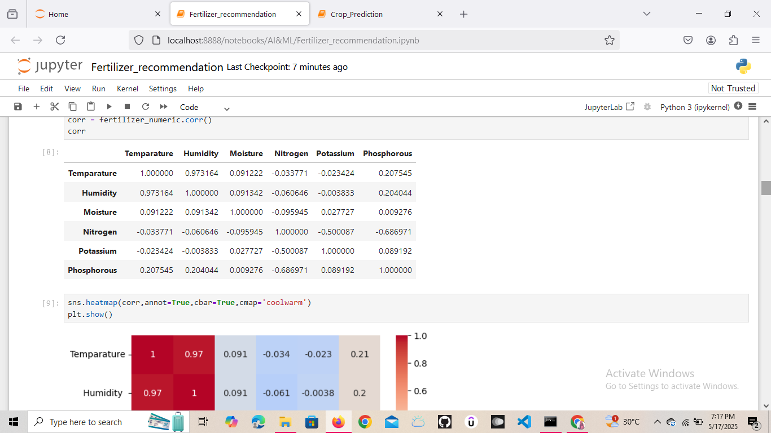
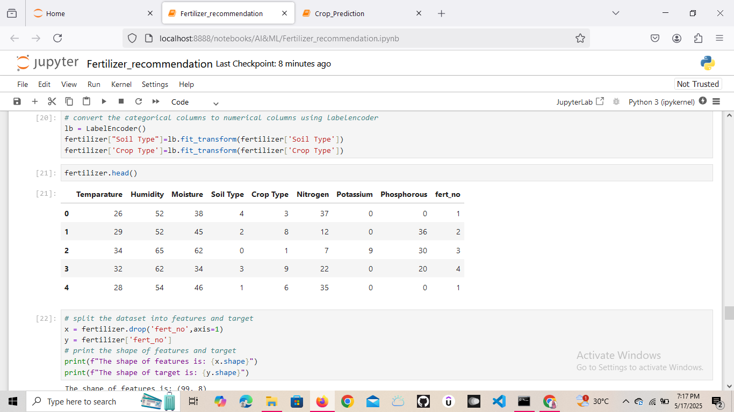

Slide 10
Conclusion:
A Machine Learning-based Crop and Fertilizer Recommendation System empowers farmers with data-driven decisions.
It enhances crop yield, optimizes fertilizer usage, and supports sustainable agriculture.
The system is scalable, customizable for regional needs, and has the potential to transform traditional farming through technology.
With proper deployment and user adoption, it can help bridge the gap between modern AI tools and real-world farming practices.

Slide 11
GitHub Link:
https://github.com/bashayer2004/AICTE-AI-ML-Weak_3-Project-Submission.git

Slide 12
THANK YOU

